Slide 1


Data Mining and Data Warehousing
CSE-4107
Md. Manowarul Islam
Associate Professor, Dept. of CSE
Jagannath University

Slide 2
Apriori-like Algorithms
Algorithm
  Generating candidate set
  Testing candidate set
Two non-trivial costs: (Bottleneck)
  Candidate sets are huge. (They are pruned already but still increase exponentially with stage number k).
  Repeated scan the database and test the candidate set by pattern matching.

Slide 3
Bottleneck of Frequent-pattern Mining
Multiple database scans are costly
Mining long patterns needs many passes of scanning and generates lots of candidates
  To find frequent itemset i₁i₂…i₁₀₀
    # of scans: 100
    # of Candidates: (₁₀₀¹) + (₁₀₀²) + … + (₁¹₀⁰₀⁰) = 2¹⁰⁰-1 = 1.27*10³⁰ !
Bottleneck: candidate-generation-and-test
Can we avoid candidate generation?

Slide 4
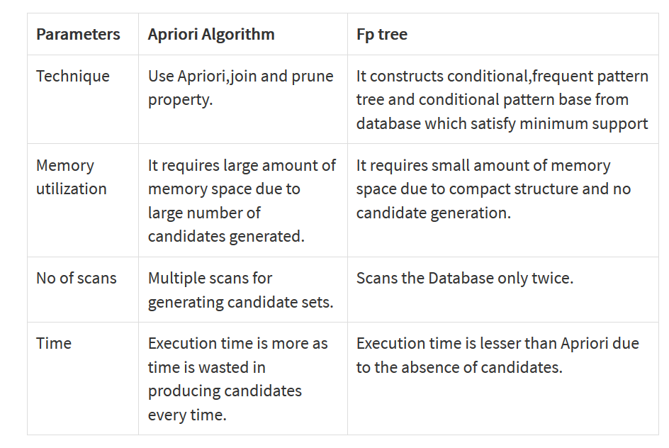

Slide 5
FP-Tree and FP-Growth Algorithm
FP-Tree: Frequent Pattern Tree
  Compact presentation of the DB without information loss.
  Easy to traverse, can quickly find out patterns associated with a certain item.
  Well-ordered by item frequency.
FP-Growth Algorithm
  Start mining from length-1 patterns
  Recursively do the following
    Constructs its conditional FP-tree
    Concatenate patterns from conditional FP-tree with suffix

Slide 6
FP-growth: Mining Frequent Patterns
Compress a large database into a compact, Frequent-Pattern tree (FP-tree) structure
  highly condensed, but complete for frequent pattern mining
  avoid costly database scans
Develop an efficient, FP-tree-based frequent pattern mining method
  A divide-and-conquer methodology: decompose mining tasks into smaller ones
  Avoid candidate generation: sub-database test only!

Slide 7
FP-tree Construction
min_support = 3
TID Items bought (ordered) frequent items
100 {f, a, c, d, g, i, m, p} {f, c, a, m, p}
200 {a, b, c, f, l, m, o} {f, c, a, b, m}
300 {b, f, h, j, o} {f, b}
400 {b, c, k, s, p} {c, b, p}
500 {a, f, c, e, l, p, m, n} {f, c, a, m, p}
Item frequency
f 4
c 4
a 3
b 3
m 3
p 3
Steps:
Scan DB once, find frequent 1-itemsets (single item patterns)
Order frequent items in descending order of their frequency
Scan DB again, construct FP-tree

Slide 8
FP-tree Construction
min_support = 3
TID freq. Items bought
100 {f, c, a, m, p}
200 {f, c, a, b, m}
300 {f, b}
400 {c, p, b}
500 {f, c, a, m, p}
Item frequency
f 4
c 4
a 3
b 3
m 3
p 3
root
f:1
c:1
a:1
m:1
p:1

Slide 9
FP-tree Construction
min_support = 3
TID freq. Items bought
100 {f, c, a, m, p}
200 {f, c, a, b, m}
300 {f, b}
400 {c, p, b}
500 {f, c, a, m, p}
Item frequency
f 4
c 4
a 3
b 3
m 3
p 3
root
f:2
c:2
a:2
m:1
b:1
p:1
m:1

Slide 10
FP-tree Construction
min_support = 3
TID freq. Items bought
100 {f, c, a, m, p}
200 {f, c, a, b, m}
300 {f, b}
400 {c, p, b}
500 {f, c, a, m, p}
Item frequency
f 4
c 4
a 3
b 3
m 3
p 3
root
f:3
c:1
c:2
b:1
b:1
a:2
p:1
m:1
b:1
p:1
m:1

Slide 11
FP-tree Construction
TID freq. Items bought
100 {f, c, a, m, p}
200 {f, c, a, b, m}
300 {f, b}
400 {c, p, b}
500 {f, c, a, m, p}
min_support = 3
Item frequency
f 4
c 4
a 3
b 3
m 3
p 3
root
Header Table
Item frequency head
f 4
c 4
a 3
b 3
m 3
p 3
f:4
c:1
c:3
b:1
b:1
a:3
p:1
m:2
b:1
p:2
m:1

Slide 12
Mining Frequent Patterns Using FP-tree
General idea (divide-and-conquer)
  Recursively grow frequent pattern path using the FP-tree
Method
  For each item, construct its conditional pattern-base, and then its conditional FP-tree
  Repeat the process on each newly created conditional FP-tree
  Until the resulting FP-tree is empty, or it contains only one path (single path will generate all the combinations of its sub-paths, each of which is a frequent pattern)

Slide 13
Mining Frequent Patterns Using FP-tree
Bottom-up traversal of the tree. First, itemsets ending in p, then m, etc, each time a suffix-based class
TID freq. Items bought
100 {f, c, a, m, p}
200 {f, c, a, b, m}
300 {f, b}
400 {c, p, b}
500 {f, c, a, m, p}
root
Header Table
Item frequency head
f 4
c 4
a 3
b 3
m 3
p 3
f:4
c:1
c:3
b:1
b:1
a:3
p:1
m:2
b:1
p:2
m:1

Slide 14
Mining Frequent Patterns Using FP-tree
root
construct prefix tree for P
Find all prefix paths that contain p
f:4
c:1
root
c:3
b:1
b:1
f:4
c:1
Prefix path for P
a:3
p:1
c:3
b:1
m:2
b:1
a:3
p:1
p:2
m:1
m:2
p:2

Slide 15
Mining Frequent Patterns Using FP-tree
Compute Support for p (minsup = 3)
Follow pointers while summing up counts: 2+1 = 3 >=3
p is frequent
root
f:4
c:1
Prefix path for P
c:3
b:1
a:3
p:1
m:2
p:2

Slide 16
Mining Frequent Patterns Using the FP-tree
TID freq. Items bought
100 {f, c, a, m, p}
200 {f, c, a, b, m}
300 {f, b}
400 {c, b, p}
500 {f, c, a, m, p}
root
f:2
c:1
Conditional pattern base for P
c:2
b:1
The FP-Tree that would be built if we only consider transactions containing a particular itemset and then removing that itemset from all transactions.
here is for : p
a:2
m:2

Slide 17
Mining Frequent Patterns Using the FP-tree
Prune infrequent
In the conditional FP-tree some nodes may have support less than minsup
TID freq. Items bought
100 {f, c, a, m, p}
200 {f, c, a, b, m}
300 {f, b}
400 {c, b, p}
500 {f, c, a, m, p}
root
f:2
c:1
Conditional pattern base for P
c:2
b:1
a:2
m needs to be pruned m=2
a needs to be pruned a=2
b needs to be pruned b=1
f needs to be pruned f=2
m:2

Slide 18
Mining Frequent Patterns Using the FP-tree
Conditional pattern base for P
Conditional FP-tree for P
root
root
f:2
c:1
c:3
c:2
b:1
a:2
All frequent patterns that include p
{p, cp}
m:2

Slide 19
Mining Frequent Patterns Using the FP-tree
root
construct prefix tree for M
Find all prefix paths that contain m
f:4
c:1
root
c:3
b:1
b:1
f:4
a:3
p:1
c:3
m:2
b:1
Prefix path for m
a:3
p:2
m:1
m:2
b:1
m:1

Slide 20
Mining Frequent Patterns Using the FP-tree
Compute Support for m (minsup = 3)
Follow pointers while summing up counts: 2+1 = 3 >=3
m is frequent
root
f:4
Prefix path for m
c:3
a:3
m:2
b:1
m:1

Slide 21
Mining Frequent Patterns Using the FP-tree
TID freq. Items bought
100 {f, c, a, m, p}
200 {f, c, a, b, m}
300 {f, b}
400 {c, b, p}
500 {f, c, a, m, p}
root
f:3
Conditional pattern base for m
c:3
a:3
b:1

Slide 22
Mining Frequent Patterns Using the FP-tree
TID freq. Items bought
100 {f, c, a, m, p}
200 {f, c, a, b, m}
300 {f, b}
400 {c, b, p}
500 {f, c, a, m, p}
Prune infrequent
root
f:3
Conditional pattern base for m
c:3
a:3
b needs to be pruned b=1
b:1

Slide 23
Mining Frequent Patterns Using the FP-tree
Conditional pattern base for m
Conditional FP-tree for m
root
root
f:3
f:3
c:3
c:3
a:3
a:3
b:1

Slide 24
Mining Frequent Patterns Using the FP-tree
Conditional FP-tree for m
Conditional FP-tree for am
root
root
f:3
f:3
c:3
c:3
a:3
Conditional FP-tree for cam
All frequent patterns that include m
{m, fm, cm, am, fcm, fam, cam, fcam }
root
f:3

Slide 25
Mining Frequent Patterns Using the FP-tree
root
construct prefix tree for b
Find all prefix paths that contain b
f:4
c:1
root
c:3
b:1
b:1
Prefix path for b
f:4
a:3
p:1
c:1
c:3
b:1
b:1
m:2
b:1
a:3
p:2
m:1
b:1

Slide 26
Mining Frequent Patterns Using the FP-tree
Compute Support for p (minsup = 3)
Follow pointers while summing up counts: 1+1+1 = 3 >=3
b is frequent
root
Prefix path for b
f:4
c:1
c:3
b:1
b:1
a:3
b:1

Slide 27
Mining Frequent Patterns Using the FP-tree
TID freq. Items bought
100 {f, c, a, m, p}
200 {f, c, a, b, m}
300 {f, b}
400 {c, b, p}
500 {f, c, a, m, p}
root
Conditional pattern base for b
f:2
c:1
c:1
a:1

Slide 28
Mining Frequent Patterns Using the FP-tree
Prune infrequent
root
Conditional pattern base for b
f:2
c:1
c:1
a:1
f needs to be pruned f=2
c needs to be pruned c=2
a needs to be pruned a=2

Slide 29
Mining Frequent Patterns Using the FP-tree
Conditional pattern base for b
Conditional FP-tree for b
root
root
f:2
c:1
c:1
No Conditional FP-tree
a:1
All frequent patterns that include b
{b}

Slide 30
Mining Frequent Patterns Using the FP-tree
root
construct prefix tree for a
Find all prefix paths that contain a
f:4
c:1
root
c:3
b:1
b:1
f:4
a:3
p:1
c:3
Prefix path for a
m:2
b:1
a:3
p:2
m:1

Slide 31
Mining Frequent Patterns Using the FP-tree
Compute Support for p (minsup = 3)
Follow pointers while summing up counts: 3 >=3
a is frequent
root
f:4
Prefix path for a
c:3
a:3

Slide 32
Mining Frequent Patterns Using the FP-tree
TID freq. Items bought
100 {f, c, a, m, p}
200 {f, c, a, b, m}
300 {f, b}
400 {c, b, p}
500 {f, c, a, m, p}
root
f:3
Conditional pattern base for a
c:3

Slide 33
Mining Frequent Patterns Using the FP-tree)
Prune infrequent
TID freq. Items bought
100 {f, c, a, m, p}
200 {f, c, a, b, m}
300 {f, b}
400 {c, b, p}
500 {f, c, a, m, p}
root
f:3
Conditional pattern base for a
c:3

Slide 34
Mining Frequent Patterns Using the FP-tree
Conditional pattern base for a
Conditional FP-tree for a
root
root
f:3
f:3
c:3
c:3
All frequent patterns that include a
{a, fa, ca, fcm}

Slide 35
Mining Frequent Patterns Using the FP-tree
construct prefix tree for c
Find all prefix paths that contain c
root
Prefix path for c
f:4
c:1
c:3

Slide 36
Mining Frequent Patterns Using the FP-tree
Compute Support for c (minsup = 3)
Follow pointers while summing up counts: 3+1 >=3
c is frequent
root
Prefix path for c
f:4
c:1
c:3

Slide 37
Mining Frequent Patterns Using the FP-tree
TID freq. Items bought
100 {f, c, a, m, p}
200 {f, c, a, b, m}
300 {f, b}
400 {c, b, p}
500 {f, c, a, m, p}
root
Conditional pattern base for c
f:3

Slide 38
Mining Frequent Patterns Using the FP-tree
Prune infrequent
TID freq. Items bought
100 {f, c, a, m, p}
200 {f, c, a, b, m}
300 {f, b}
400 {c, b, p}
500 {f, c, a, m, p}
root
Conditional pattern base for c
f:3

Slide 39
Mining Frequent Patterns Using the FP-tree
Conditional pattern base for c
Conditional FP-tree for c
root
root
f:3
f:3
All frequent patterns that include c
{c,fc}

Slide 40
Mining Frequent Patterns Using the FP-tree
construct prefix tree for f
Find all prefix paths that contain f
root
f:4
Compute Support for f (minsup = 3)
Follow pointers while summing up counts: 4>=3
f is frequent

Slide 41
Mining Frequent Patterns Using the FP-tree
Conditional pattern base for f
Conditional pattern base for f
root
root
f:4
All frequent patterns that include f
{f}
DONE……….

Slide 42
Conditional Pattern-Bases for the example
Item
Conditional pattern-base
Conditional FP-tree
p
{(fcam:2), (cb:1)}
{(c:3)}|p
m
{(fca:2), (fcab:1)}
{(f:3, c:3, a:3)}|m
b
{(fca:1), (f:1), (c:1)}
Empty
a
{(fc:3)}
{(f:3, c:3)}|a
c
{(f:3)}
{(f:3)}|c
f
Empty
Empty

Slide 43
FP-Tree Another Example
Transactions
Freq. 1-Itemsets.
Supp. Count ≥2
Transactions with items sorted based on frequencies, and ignoring the infrequent items.
A B C E F O
A C G
E I
A C D E G
A C E G L
E J
A B C E F P
A C D
A C E G M
A C E G N
A:8
C:8
E:8
G:5
B:2
D:2
F:2
A C E B F
A C G
E
A C E G D
A C E G
E
A C E B F
A C D
A C E G
A C E G

Slide 44
FP-Tree after reading 1st transaction
A C E B F
A C G
E
A C E G D
A C E G
E
A C E B F
A C D
A C E G
A C E G
Header
null
A:8
C:8
E:8
G:5
B:2
D:2
F:2
A:1
C:1
E:1
B:1
F:1

Slide 45
FP-Tree after reading 2nd transaction
A C E B F
A C G
E
A C E G D
A C E G
E
A C E B F
A C D
A C E G
A C E G
Header
null
A:8
C:8
E:8
G:5
B:2
D:2
F:2
A:2
C:2
E:1
G:1
B:1
F:1

Slide 46
FP-Tree after reading 3rd transaction
A C E B F
A C G
E
A C E G D
A C E G
E
A C E B F
A C D
A C E G
A C E G
Header
null
A:8
C:8
E:8
G:5
B:2
D:2
F:2
A:2
E:1
C:2
E:1
G:1
B:1
F:1

Slide 47
FP-Tree after reading 4th transaction
A C E B F
A C G
E
A C E G D
A C E G
E
A C E B F
A C D
A C E G
A C E G
Header
null
A:8
C:8
E:8
G:5
B:2
D:2
F:2
A:3
E:1
C:3
E:2
G:1
G:1
B:1
F:1
D:1

Slide 48
FP-Tree after reading 5th transaction
A C E B F
A C G
E
A C E G D
A C E G
E
A C E B F
A C D
A C E G
A C E G
Header
null
A:8
C:8
E:8
G:5
B:2
D:2
F:2
A:4
E:1
C:4
E:3
G:1
G:2
B:1
F:1
D:1

Slide 49
FP-Tree after reading 6th transaction
A C E B F
A C G
E
A C E G D
A C E G
E
A C E B F
A C D
A C E G
A C E G
Header
null
A:8
C:8
E:8
G:5
B:2
D:2
F:2
A:4
E:2
C:4
E:3
G:1
G:2
B:1
F:1
D:1

Slide 50
FP-Tree after reading 7th transaction
A C E B F
A C G
E
A C E G D
A C E G
E
A C E B F
A C D
A C E G
A C E G
Header
null
A:8
C:8
E:8
G:5
B:2
D:2
F:2
A:5
E:2
C:5
E:4
G:1
G:2
B:2
F:2
D:1

Slide 51
FP-Tree after reading 8th transaction
A C E B F
A C G
E
A C E G D
A C E G
E
A C E B F
A C D
A C E G
A C E G
Header
null
A:8
C:8
E:8
G:5
B:2
D:2
F:2
A:6
E:2
C:6
E:4
G:1
D:1
G:2
B:2
F:2
D:1

Slide 52
FP-Tree after reading 9th transaction
A C E B F
A C G
E
A C E G D
A C E G
E
A C E B F
A C D
A C E G
A C E G
Header
null
A:8
C:8
E:8
G:5
B:2
D:2
F:2
A:7
E:2
C:7
E:5
G:1
D:1
G:3
B:2
F:2
D:1

Slide 53
FP-Tree after reading 10th transaction
A C E B F
A C G
E
A C E G D
A C E G
E
A C E B F
A C D
A C E G
A C E G
Header
null
A:8
C:8
E:8
G:5
B:2
D:2
F:2
A:8
E:2
C:8
E:6
G:1
D:1
G:4
B:2
F:2
D:1

Slide 54
Conditional FP-Tree for F
Header
null
null
New Header
A:8
C:8
E:8
G:5
B:2
D:2
F:2
A:8
A:2
C:2
E:2
B:2
A:2
C:8
A C E B F
A C G
E
A C E G D
A C E G
E
A C E B F
A C D
A C E G
A C E G
C:2
E:6
E:2
B:2
B:2
F:2
There is only a single path containing F

Slide 55
Recursion
We continue recursively on the conditional FP-Tree for F.
However, when the tree is just a single path it is the base case for the recursion.
So, we just produce all the subsets of the items on this path merged with F.
{F} {A,F} {C,F} {E,F} {B,F} {A,C,F}, …,
{A,C,E,F}
null
New Header
A:6
C:6
E:5
B:2
A:2
C:2
E:2
B:2

Slide 56
Recursion
null
null
null
A:2
null
A:2
A:2
A:2
C:2
C:2
C:2
E:2
E:2
B:2
So, we just produce all the subsets of the items on this path merged with F.
{F} {A,F} {C,F} {E,F} {B,F} {A,C,F},{A,E,F}{A,B,F},{C,E,F}, {C,B,F},{E,B,F} {A,C,E,F}……

Slide 57
Conditional FP-Tree for D
null
A C E B F
A C G
E
A C E G D
A C E G
E
A C E B F
A C D
A C E G
A C E G
null
A:8
A:2
C:8
C:2
E:6
D:1
E:1
G:4
G:1
D:1
Paths containing D after updating the counts

Slide 58
Conditional FP-Tree for D
null
A C E B F
A C G
E
A C E G D
A C E G
E
A C E B F
A C D
A C E G
A C E G
New Header
null
A:2
A:2
C:2
A:2
C:2
C:2
The other items are removed as infrequent.
E:1
The tree is just a single path; it is the base case for the recursion.
So, we just produce all the subsets of the items on this path merged with D.
{D} {A,D} {C,D} {A,C,D}
G:1

Slide 59
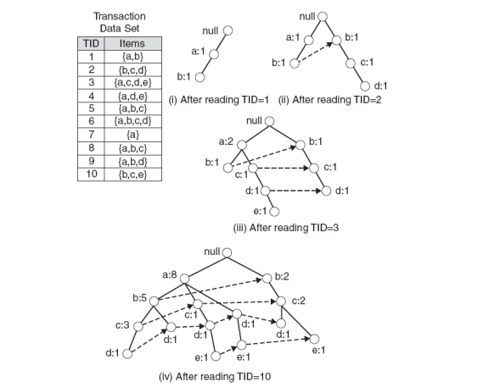
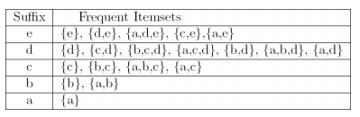
minSup = 2

Slide 60
Discusion
Advantages of FP-Growth
  only 2 passes over data-set
  “compresses” data-set
  no candidate generation
  much faster than Apriori
Disadvantages of FP-Growth
  FP-Tree may not fit in memory!!
  FP-Tree is expensive to build

Slide 61
Thank you

